Slide 1
AMSAT Engineering Program
Jerry buxton, nØjy
Vice president – engineering
amsat

Slide 2
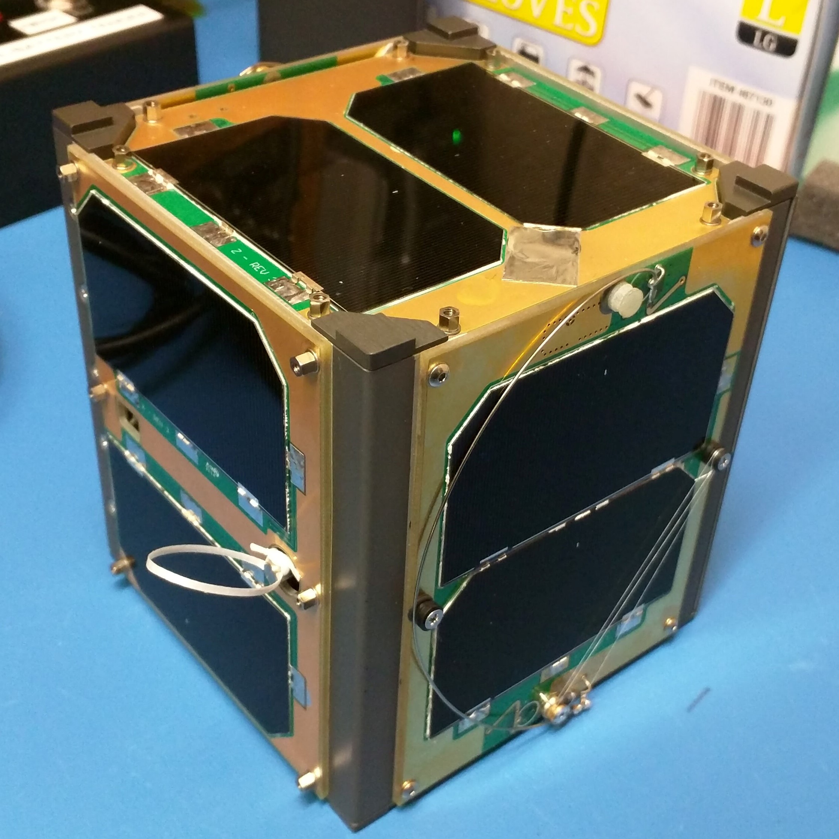
Fox-1 CubeSats

Slide 3
Fox-1 CubeSats
Fox-1A AO-85 Launched 10/08/2015 Operational
Fox-1B/RadFxSat AO-91 Launched 11/18/2017 Operational
Fox-1D AO-92 Launched 01/12/2018 Operational
Fox-1Cliff --- Launch by the end of 2018
Fox-1E/RadFxSat-2 --- Launch by the end of 2018

Slide 4
Transponder Fox-1A-D
Single channel FM transponder
Mode U/v (70cm UHF uplink, 2m VHF downlink)
AFC on receiver to help compensate for Doppler shift
Except Fox-1Cliff
Fox-1Cliff and Fox-1D have L band “Downshifter”
Mode L/v (23cm L band uplink, 2m VHF downlink
Telemetry downlink simultaneous with transponder voice signals
DUV (Data Under Voice)

Slide 5
Transponder Fox-1E
30 kHz wide linear transponder
Mode V/u (2m VHF uplink, 70cm UHF downlink)
SSB, CW, etc. – No 100% duty cycle modulation types
Separate telemetry channel downlink

Slide 6
Fox-1 CubeSats
Lives up to the EasySat claim
Can work with a handheld with ¼ wave COTS antenna* even on L/v
Attracting new satellite enthusiasts
Cheap test drive
* Professional amateur on a closed transponder. Do not attempt on a busy pass. Your experience may vary due to local conditions, the number of satellite users, and your individual skill level.

Slide 7
For more insight on what it takes to get a Fox-1 in orbit
Watch live stream video of Fox-1E testing over the next two weeks at
www.twitch.tv/n0jy
Live stream archives and lots of other Fox-1 videos are available at
www.youtube.com/n0jy

Slide 8
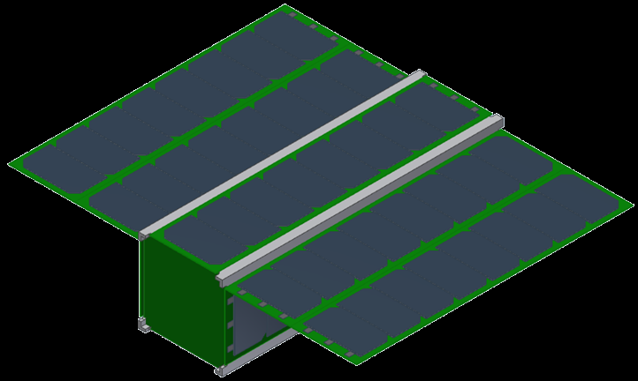
GOLF Program Greater Orbit, Larger Footprint
GOLF-TEE SUGGESTION

Slide 9
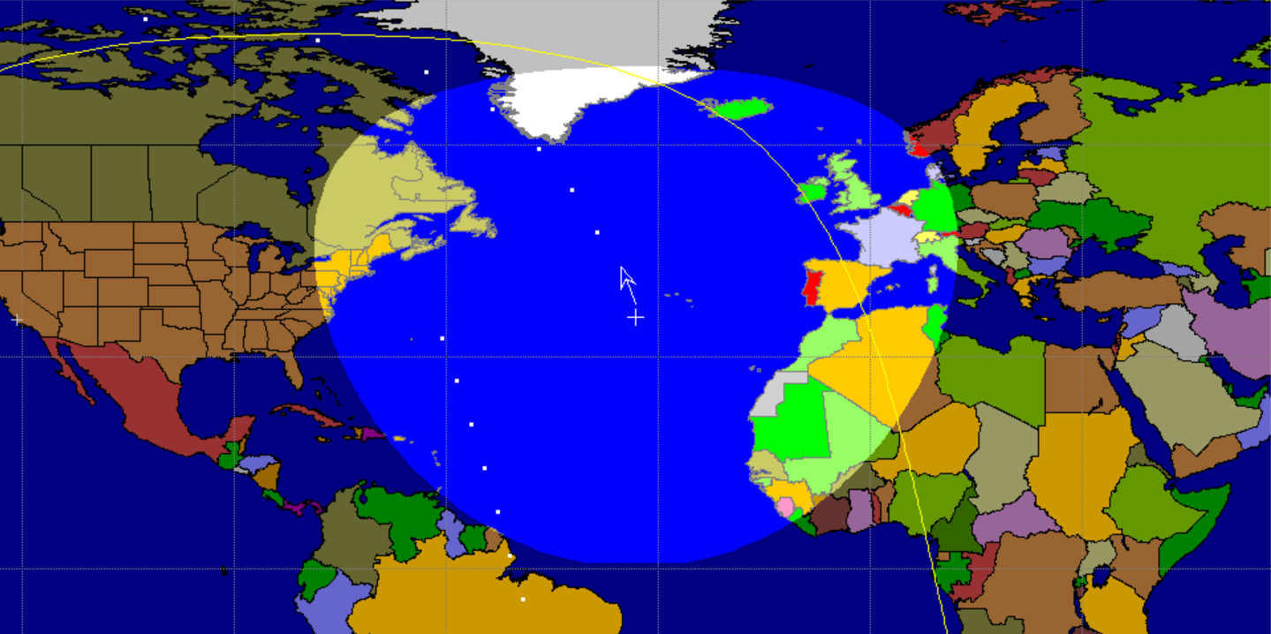
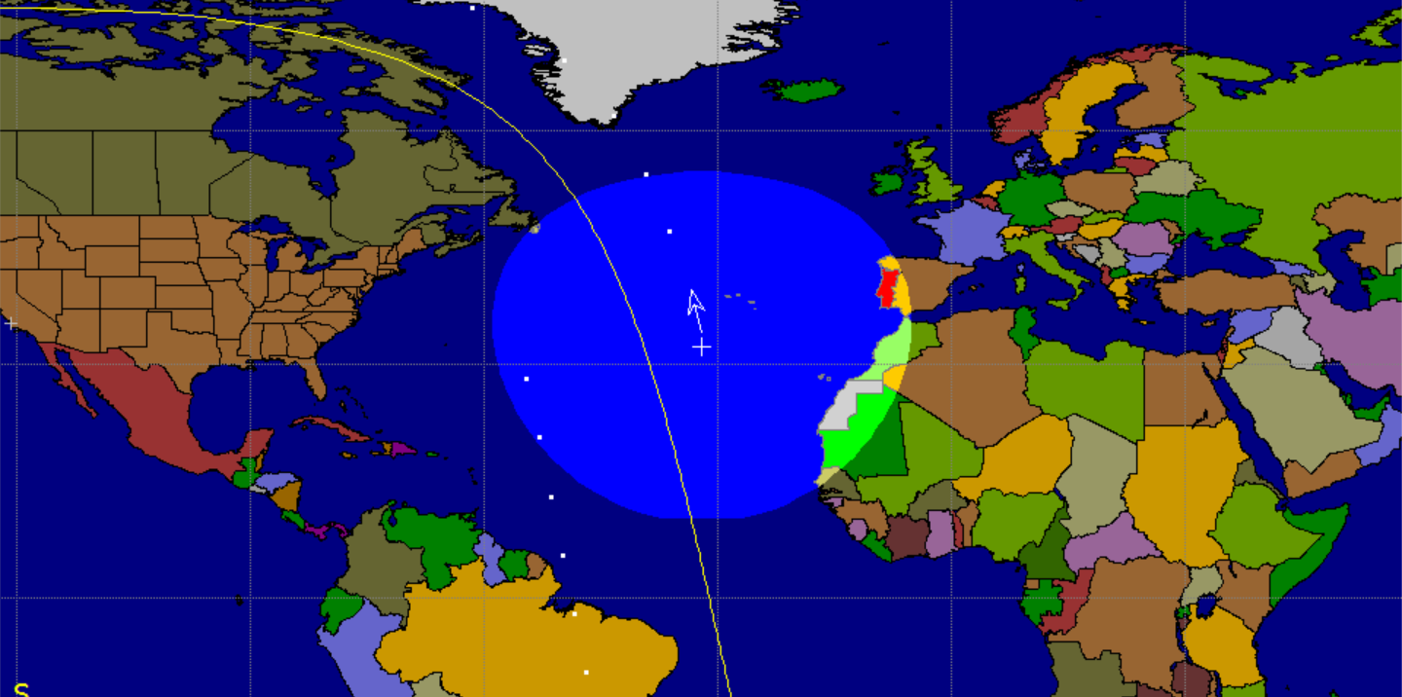
Amateur Radio LEO Satellite Altitudes (voice)
AO-7 ≈ 1400 km.
FO-29 ≈ 1200 km.
SO-50 ≈ 650 km.
AO-73 ≈ 650 km.
AO-85 ≈ 650 km.
XW-2F ≈ 520 km.
ISS ≈ 400 km.

Slide 10
Higher is Better
Larger footprint
More DX
More good passes per day (mid-latitude station)
Orbit lifetime is longer
SSO typically 6 to 8 years
AO-7 will last a lifetime
Slower motion across sky
Longer passes
Less tracking movements

Slide 11
GOLF Program
3U CubeSats
Incremental path to MEO, HEO, GEO orbits and missions
Developing, testing, learning, and building proficiency for reduced risk
New Technology
ADAC
Deployable solar panels
SDR and microwave bands
Propulsion
Develop and learn de-orbit capability (passive or active) for all future missions
Any higher orbit (not including rideshare) must meet orbital debris requirements

Slide 12
GOLF Program
Continued growth of CubeSat abilities
Hands on knowledge and experience builds team capability for HEO
Following Fox-1, continues to regularly populate amateur radio satellites providing coverage for years to come
Continuation of CSLI educational launch opportunities and partnerships

Slide 13
GOLF-TEE (Technology Exploration Environment) Target: 4Q 2019 delivery
500-600 km polar orbit
Fox-1E type V/u linear transponder
SDR with X band data downlink
V/x transponder option
Attitude determination and control
Deployable solar panels
Radiation tolerant IHU (Integrated Housekeeping Unit)
Vanderbilt University radiation experiment

Slide 14
GOLF-1 Target: 4Q 2020 delivery
1300 km orbit
SDX (Software Defined radio Transponder)
C/x (“Five and Dime”) linear transponder
V/u linear transponder
Other bands/modes possible
Albuquerque Public Schools / Virginia Tech weather observation camera experiment
Vanderbilt University radiation experiment
De-orbit capability

Slide 15
Attitude Determination And Control - Benefits
Solar panel pointing for best sun
Antenna pointing for best transponder performance
Higher gain microwave band antennas
Camera pointing
Support for de-orbit mechanism performance
Support for propulsion
Some options for collision avoidance

Slide 16
Microwave Bands - Benefits
Smaller antennas (wavelength)
Higher gain both space and ground segment
Opportunities for stations in neighborhoods with restrictions
Opportunities for apartment dwellers
Lots more bandwidth available
5 GHZ band – 20 MHz uplink, 20 MHz downlink (separate segments)
10 GHz band – 50 MHz (combined up/down segment)
Opportunity for a variety of signals on one band
FM, SSB, digital (high speed), you name it

Slide 17
Q&A
Doors will remain locked until someone asks a question

Slide 18
Visit us at the AMSAT booth!

